Slide 1
Software Project Management
Planning
Dr. Seemab Latif
Lecture No. 4
2nd March, 2011

Slide 2
Today
Phases in Detail
Step-by-step of typical software project
Lifecycle Planning
Project plans
Next Lecture: Lots of Project-ish Details: WBS, PERT, CPM, Scheduling & Estimation
Notes:
No lab today
More lab in later term

Slide 3
Session 2 and 3 Review
PMI Fundamentals
PMI Processes
Project Organization
Functional, Project, Matrix Orgs.
Initial documents
Statement of Work (SOW)
Project Charter
Readings

Slide 4
Project Phases

Slide 5
Time Allocation by Phase
Remember the 40-20-40 Rule
Specification-Implementation-Test
40% front-end analysis and design
20% coding
40% back-end testing
 | Planning | Code & Unit Test | Integration & Test
Commercial Development | 25% | 40% | 35%
Internet Systems | 55% | 15% | 30%
Real-time Systems | 35% | 25% | 40%
Defense Systems | 40% | 20% | 40%
Bennatan, E.M, “On Time Within Budget”

Slide 6
Time Allocation by Phase
Activity | Small Project (2.5K LOC) | Large Project (500K LOC)
Analysis | 10% | 30%
Design | 20% | 20%
Code | 25% | 10%
Unit Test | 20% | 5%
Integration | 15% | 20%
System test | 10% | 15%
McConnell, Steve, “Rapid Development”

Slide 7
Activities by % of Total Effort
NASA’s “Manager’s Handbook for Software Development”, page 10

Slide 8
Potential Deliverables by Phase

Slide 9
Concept Exploration
The “Why” phase
Not a “mandatory formal” phase
Sometimes called the “pre-project” phase
Collecting project ideas
Then the “funneling” process
Project Justification
ROI—Return On Investment
Cost-benefit analysis
Project Portfolio Matrix
Initial planning and estimates

Slide 10
Concept Exploration
Possibly includes Procurement Management:
RFP Process
Vendor selection
Contract management
Gathering the initial team
Including PM if not already on-board
Identify the project sponsor
Primary contact for approval and decision making
Potential Phase Outputs:
Concept Document, Product Description, Proposal, SOW, Project Charter

Slide 11
Concept Exploration
Characteristics & Issues
Lack of full commitment and leadership
Some frustrations:
Management only getting rough estimates from development
Development not getting enough specifics from customer
Finding a balanced team
Budget sign-off may be your 1st major task
Achieved via:
Good concept document or equivalent
Demonstration of clear need (justification)
Initial estimates

Slide 12
Requirements
The “What” phase
Inputs: SOW, Proposal
Outputs:
Requirements Document (RD)
a.k.a.Requirements Specification Document (RSD)
Software Requirements Specification (SRS)
1st Project Baseline
Software Project Management Plan (SPMP)
Requirements Approval & Sign-Off
Your most difficult task in this phase

Slide 13
Requirements
Perhaps most important & difficult phase
Shortchanging it is a ‘classic mistake’
Can begin with a Project Kickoff Meeting
Can end with a Software Requirements Review (SRR)
For Sponsor and/or customer(s) approval

Slide 14
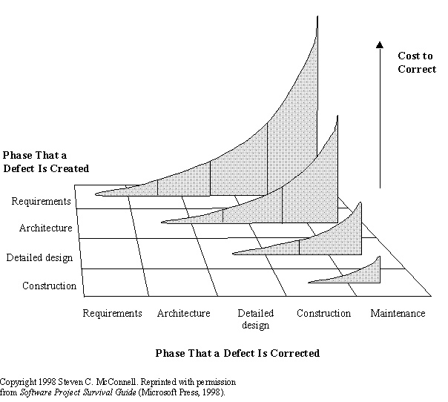
Why are Requirements so Important?

Slide 15
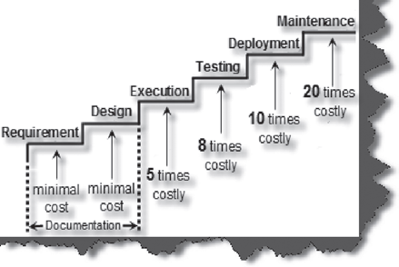
Cost of removing defects
The cost of removing defects increases exponentially. A defect caught in requirement and design phase costs less to fix than an error caught in the software maintenance cycle.
Cost of defect increases with each phase

Slide 16
Requirements
Characteristics & Issues
Conflict of interest: developer vs. customer
Potential tug-of-war:
Disagreement on Features & Estimates
Especially in fixed-price contracts
Frequent requirements changes
Achieving sign-off
Project planning occurs in parallel

Slide 17
Requirements
Requirements are capabilities and condition to which the system – more broadly, the project – must conform

Slide 18
2 Types of Requirements
Functional (behavioral)
Features and capabilities
Non-functional (a.k.a. “technical”) (everything else)
Usability
Human factors, help, documentation
Reliability
Failure rates, recoverability, availability
Performance
Response times, throughput, resource usage
Supportability
Maintainability, internationalization
Operations: systems management, installation
Interface: integration with other systems
Other: legal, packaging, hardware

Slide 19
Requirements
Other ways of categorizing
Go-Ahead vs. Catch-up
Relative to competition
Backward-looking vs. Forward-looking
Backward: address issues with previous version
Forward: Anticipating future needs of customers
Must be prioritized
Must-have
Should-have
Could-have (Nice-to-have: NTH)
Must be approved

Slide 20
Early Phase Meetings
Project Kickoff Meeting
Project Brainstorming Meeting
Clarify goals, scope, assumptions
Refine estimates
WBS Meeting

Slide 21
Analysis & Design
The “How” Phases
Inputs: Requirements Document
Outputs:
Functional Specification
Detailed Design Document
User Interface Specification
Data Model
Prototype (can also be done with requirements)
Updated Plan (improved estimates; new baseline)

Slide 22
Analysis & Design
a.k.a. Top-level design & detailed design
Continues process from RD
Ends with Critical Design Review (CDR)
Formal sign-off
Can also include earlier Preliminary Design Review (PDR) for high level design

Slide 23
Analysis & Design
Characteristics & Issues
Enthusiasm via momentum
Team structure and assignments finalized
Delays due to requirements changes, new information or late ideas
Issues around personnel responsibilities
Unfeasible requirements (technical complexity)
Resource Issues
Including inter-project contention

Slide 24
Development
The “Do It” phase
Coding & Unit testing
Often overlaps Design & Integration phases
To shorten the overall schedule
PM needs to coordinate this

Slide 25
Development
Other concurrent activities
Design completion
Integration begins
Unit testing of individual components
Test bed setup (environment and tools)
Project plans updated
Scope and Risk Management conducted

Slide 26
Development
Characteristics
Pressure increases
Staffing at highest levels
Often a “heads-down” operation
Issues
Last-minute changes
Team coordination (esp. in large projects)
Communication overhead
Management of sub-contractors

Slide 27
Integration & Test
Evolves from Dev. Phase
Often done as 2 parallel phases
Partial integration & initial test
Starts with integration of modules
An initial, incomplete version constructed
Progressively add more components

Slide 28
Integration & Test
Integration primarily a programmer task
Test primarily a QA team task
Integration:
Top-down: Core functionality first, empty shells for incomplete routines (stubs)
Bottom up: gradually bind low-level modules
Prefer top-down generally

Slide 29
Integration & Test
Tests
Integration testing
Black & White-box testing
Load & Stress testing
Alpha & Beta testing
Acceptance testing
Other activities
Final budgeting; risk mgmt.; training; installation preparation; team reduced

Slide 30
Integration & Test
Characteristics & Issues
Increased pressure
Overtime
Customer conflicts over features
Frustration over last-minute failures
Budget overruns
Motivation problems (such as burnout)
Difficulty in customer acceptance
Esp. true for fixed-price contracts

Slide 31
Deployment & Maintenance
Installation depends on system type
Web-based, CD-ROM, in-house, etc.
Migration strategy
How to get customers up on the system
Parallel operation
Deployment typically in your project plan, maintenance not

Slide 32
Deployment & Maintenance
Maintenance
Fix defects
Add new features
Improve performance
Configuration control is very important here
Documents need to be maintained also
Sometimes a single team maintains multiple products

Slide 33
Deployment & Maintenance
Characteristics & Issues
Lack of enthusiasm
Pressure for quick fixes
Insufficient budget
Too many patches
Personnel turnover
Regression testing is critical
Preferably through automated tools

Slide 34
Lifecycle Planning
a.k.a. Lifecycle Management or SDLC
Greatly influences your chance of success
Not choosing a lifecycle is a bad option
Three primary lifecycle model components
Phases and their order
Intermediate products of each phase
Reviews used in each phase

Slide 35
Lifecycle Planning
Different projects require different approaches
You do not need to know all models by name
You should know how that if given a certain scenario what sort of SDLC would be appropriate
A lifecycle is not a design, modeling or diagramming technique
The same technique (UML, DFD, etc) can be used with multiple lifecycles

Slide 36
Life Cycle Planning
Read Mc Connel’s book “Rapid Development” Chapter 7 “Life Cycle Planning”
Pure Waterfall
Code-and-Fix
Spiral
Evolutionary Prototyping
Modified Waterfall
Staged Delivery
V Model
Commercial Off-the-Shelf Software
Choosing the Most Rapid Lifecycle for Your Project
X-treme Programing
Agile Modes

Slide 37
Pure Waterfall
The “granddaddy” of models
Linear sequence of phases
“Pure” model: no phases overlap
Document driven
All planning done up-front

Slide 38
Waterfall Risk
Why does the waterfall model “invite risk”?
Integration and testing occur at the end

Slide 39
Pure Waterfall
Works well for projects with
Stable product definition
Well-understood technologies
Quality constraints stronger than cost & schedule
Technically weak staff
Provides structure
Good for overseas projects

Slide 40
Pure Waterfall
Disadvantages
Not flexible
Rigid march from start->finish
Difficult to fully define requirements up front
Can produce excessive documentation
Few visible signs of progress until the end

Slide 41
Code-and-Fix
“Code-like-Hell”
Specification (maybe), Code (yes), Release (maybe)
Advantages
No overhead
Requires little expertise
Disadvantages
No process, quality control, etc.
Highly risky
Suitable for prototypes or throwaways

Slide 42
Spiral

Slide 43
Spiral
Emphasizes risk analysis & mgmt. in each phase
A Series of Mini-projects
Each addresses a set of “risks”
Start small, explore risks, prototype, plan, repeat
Early iterations are “cheapest”
Number of spirals is variable
Last set of steps are waterfall-like

Slide 44
Spiral
Advantages
Can be combined with other models
As costs increase, risks decrease
Risk orientation provides early warning
Disadvantages
More complex
Requires more management

Slide 45
Modified Waterfall – Sashimi
Overlapping phases
Advantages
Reduces overall schedule
Reduces documentation
Works well if personnel continuity
Disadvantages
Milestones more ambiguous
Progress tracking more difficult
Communication can be more difficult

Slide 46
Evolutionary Prototyping
Design most prominent parts first
Usually via a visual prototype
Good for situations with:
Rapidly changing requirements
Non-committal customer
Vague problem domain
Provides steady, visible progress
Disadvantages
Time estimation is difficult
Project completion date may be unknown
An excuse to do “code-and-fix”

Slide 47
Staged Delivery
Waterfall steps through architectural design
Then detailed design, code, test, deliver in stages
Advantages
Customers get product much sooner
Tangible signs of progress sooner
Problems discovered earlier
Increases flexibility
Reduces: status reporting overhead & estimation error
Disadvantages
Requires more planning (for you the PM)
More releases increase effort (and possible feature creep)
How’s this differ from Evolutionary Prototyping?

Slide 48
V Process Model

Slide 49
V Process Model
Designed for testability
Emphasizes Verification & Validation
Variation of waterfall
Strengths
Encourages V&V at all phases
Weaknesses
Does not handle iterations
Changes can be more difficult to handle
Good choice for systems that require high reliability such as patient control systems

Slide 50
RAD
Rapid Application Development
Popular in the 80’s
1. Joint Requirements Planning (JRP)
2. Joint Application Design (JAD)
3. Construction
Heavy use of tools: code generators
Time-boxed; many prototypes
4. Cutover
Good for systems with extensive user input available

Slide 51
COTS
Commercial Off-The-Shelf software
Build-vs.-buy decision
Advantages
Available immediately
Potentially lower cost
Disadvantages
Not as tailored to your requirements
Remember: custom software rarely meets its ideal (so compare that reality to COTS option)

Slide 52
XP: eXtreme Programming
Not a Microsoft product
Part of movement called “Agile Development”
A “Lightweight” methodology
A bit counter-culture
Currently in vogue
Motto: “Embrace Change”
Highly Incremental / Iterative

Slide 53
eXtreme Programming

Slide 54
eXtreme Programming
Suitable for small groups
Attempts to minimize unnecessary work
Uses an “on-site” customer
Small releases
Pair programming
Refactoring
Stories as requirements
You want good developers if you use this

Slide 55
Other “Agile” Methodologies
Agile here means “lite”, reduced docs, highly iterative
Agile Software Development
Alliance , their “manifesto”, their book
SCRUM
Features 30-day “Sprint” cycles
Feature Driven Development (FDD)
XP with more emphasis on docs and process

Slide 56
Other “Agile” Methodologies
Adaptive Software Development (ASD)
Book, site
Dynamic System Development Method (DSDM)
Popular in Europe
Homegrown: developers often hide their “agile adventures” from management

Slide 57
Other “Agile” Methodologies
Pros
Similar to XP, can reduce process overhead
Responsive to user feedback
Amenable to change
Cons
Requires close monitoring by PM
May not “scale” to large projects
Often requires better quality developers

Slide 58
Rational Unified Process
RUP
From Rational Corporation
“Generic” version is the Unified Process
Commercial
Extensive tool support (expensive)
Object-oriented
Incremental
Newer

Slide 59
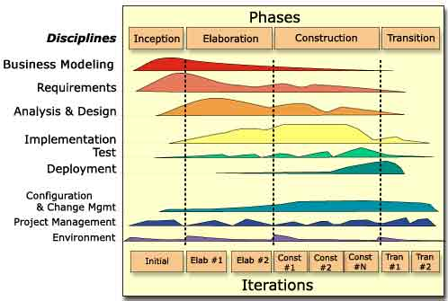
Rational Unified Process

Slide 60
Rational Unified Process
Develop Iteratively
Manage Requirements
Uses UML (Unified Modeling Language)
Produces “artifacts”
Use component-based architecture
Visually model software
Complex process
A “framework”
Suitable for large scale systems

Slide 61
Choosing Your Lifecycle
Varies by project
Opt for “iterative” or “incremental”
How well are requirements understood?
What are the risks?
Is there a fixed deadline?
How experienced is the team or customer?

Slide 62
IEEE 1074
A standard for developing software processes
Lifecycle model selection
Project management process
Predevelopment processes
Development processes
Post-development processes
Integral process

Slide 63
Planning
“Plans are nothing. But planning is everything.” Gen. Dwight Eisenhower

Slide 64
Planning
Preliminary planning starts on day one
Even in the pre-project phase
Should not be conducted “in secret”
Need buy-in and approval
Very important step
Both from above and below

Slide 65
Your PM Process
Why
Deliverable: ROI
What
SOW, Requirements
How
Design Specification, SDP, Lifecycle
Do
Execution
Done
PPR
Futrell, Shafer, Shafer, “Quality Software Project Management”

Slide 66
Primary Planning Steps
Identify project scope and objectives
Identify project organizational environment
Analyze project characteristics
Identify project products and activities
Estimate effort for each activity
Identify risk
Allocate resources
Review and communicate plan

Slide 67
Documents
Two types of documents:
Planning
Product

Slide 68
Planning Documents
Software Development Plan (SDP)
Software Quality Assurance Plan (SQAP)
Software Configuration Management Plan (SCMP)
Risk Management Plan
Software Process Improvement Plan
Communications Management Plan
Migration Plan
Operations Plan

Slide 69
Planning Documents
You (the PM) need to choose which documents are appropriate
Docs do not have to be lengthy
Small Set:
Software Development Plan
Risk Management Plan
Software Quality Assurance Plan
Software Configuration Management Plan

Slide 70
Planning Documents
Project ROI Analysis
Statement of Work (SOW)
Project Charter
Software Project Management Plan (SPMP)
Budget
Responsibility Assignment Matrix (RAM)
Risk Management Plan

Slide 71
Product Documents
Statement of Need
System Interface Specification
Software Requirements Specification
Software Design Specification
Software Validation & Verification Plan
User Documentation
Support Plan
Maintenance Documentation

Slide 72
Planning
How much will it cost?
How long will it take?
How many people will it take?
What might go wrong?

Slide 73
Planning
Scoping
Estimation
Risk
Schedule
Control Strategy

Slide 74
Process Issues
You want a fairly sophisticated process without incurring much overhead
Remember, projects are often larger than they first appear
Easier to loosen too much process than add later

Slide 75
Plans Evolve Over Time
NASA’s “Manager’s Handbook for Software Development”, page 26

Slide 76
Software Development Plan
Software Project Management Plan (SPMP)
Some consider it the most important document in the project (along with SRS)
Can be seen as an aggregation of other core documents
Evolves over time as pieces come together

Slide 77
SDP / SPMP
Fundamental Sections
Project overview
Deliverables
Project organization
Managerial processes
Technical processes
Budget
Schedule

Slide 78
Communications Management Plan
Often a section of SPMP
Describes information flow to all parties
Gathering and distributing information
Status meetings
Monthly, Weekly, Daily?
Status reports are vital

Slide 79
Create a Project Intranet
A great communications tool
Reference all project resources here

